Slide 1
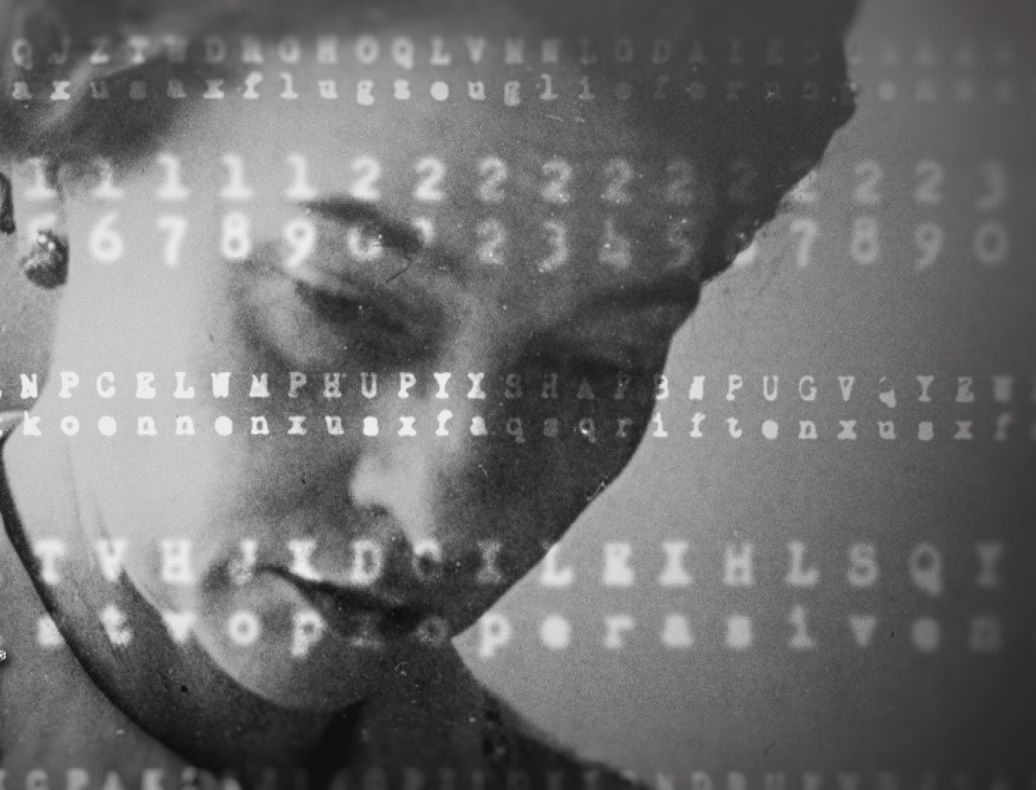

Cryptanalyst in Chief
The Story of Elizebeth Smith Friedman with Riverbank Director, Vivien Lasken

Slide 2
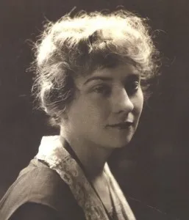
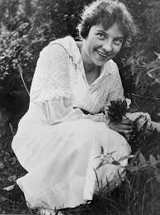
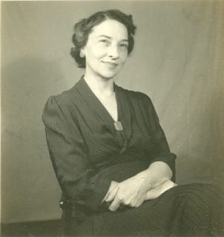
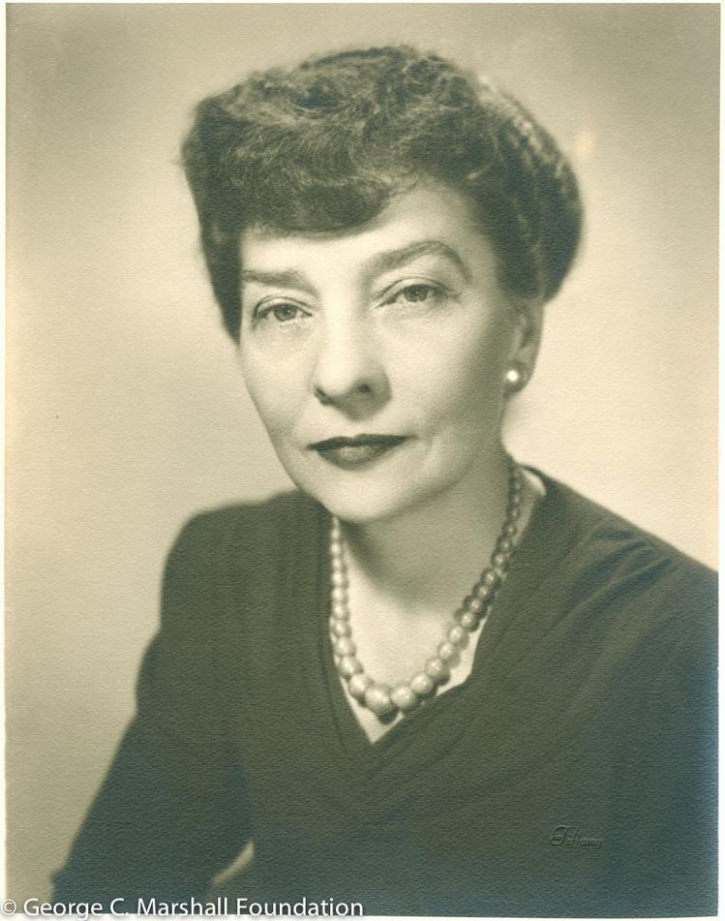
Elizabeth Smith Friedman
Born 1892 near Huntington, Indiana
The youngest of 9 children
Studied English & Greek in College

Slide 3
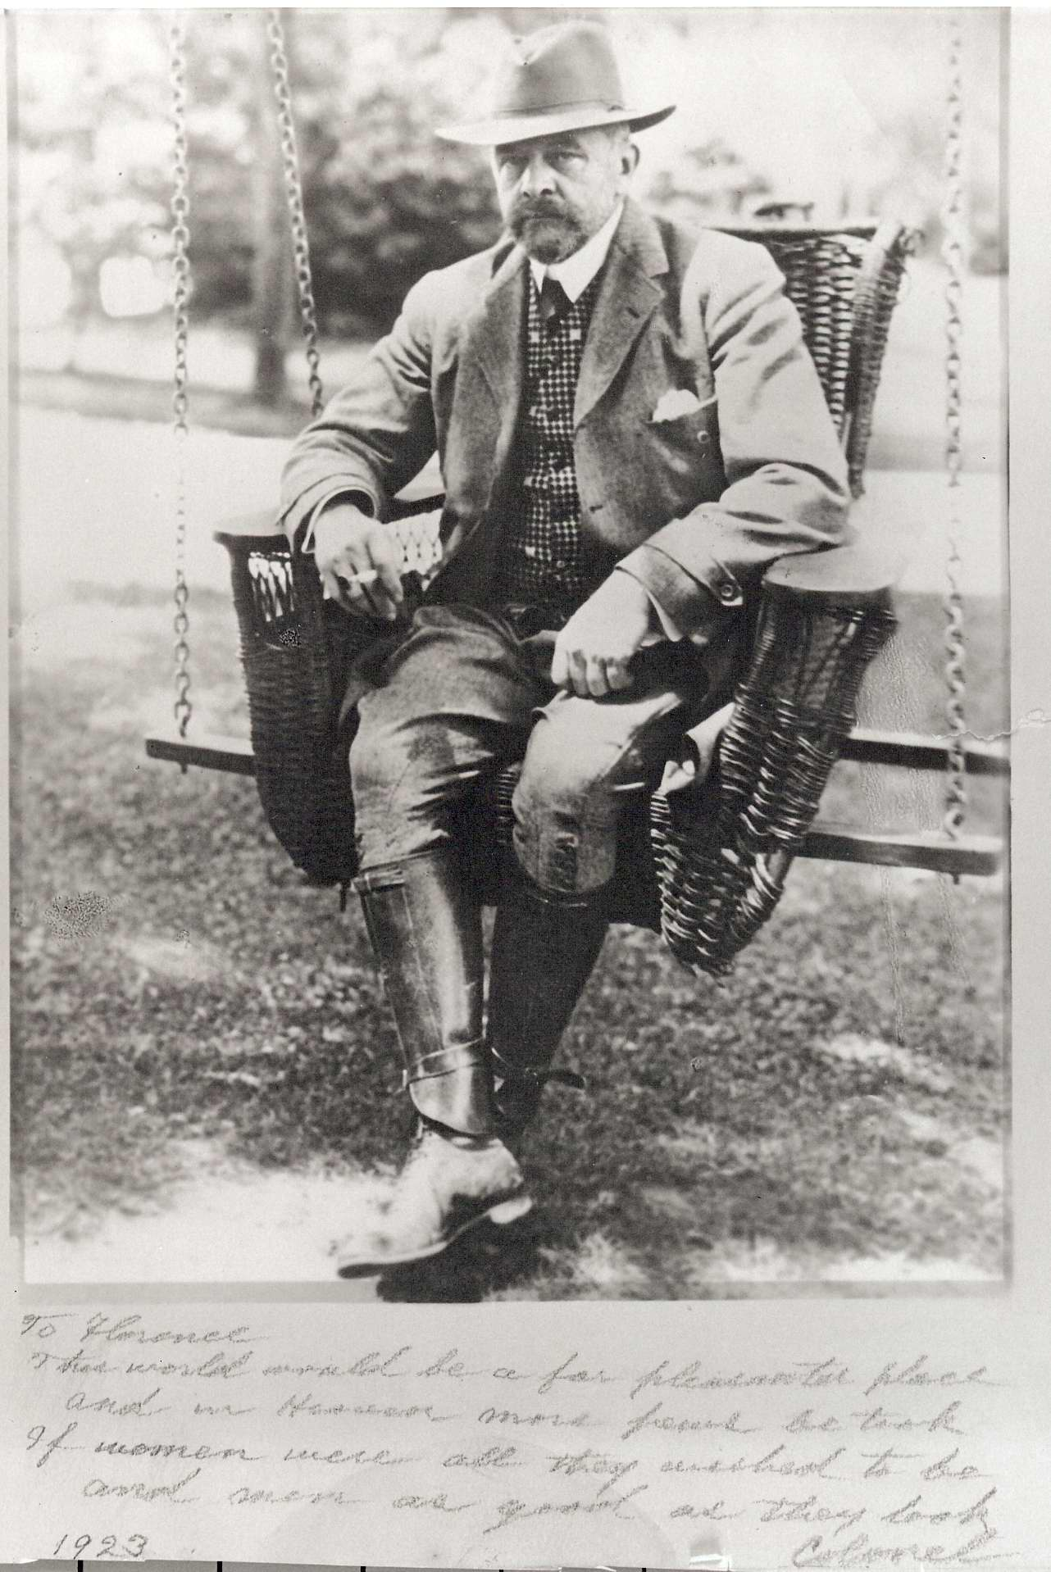
Shakespeare & The Colonel

Slide 4
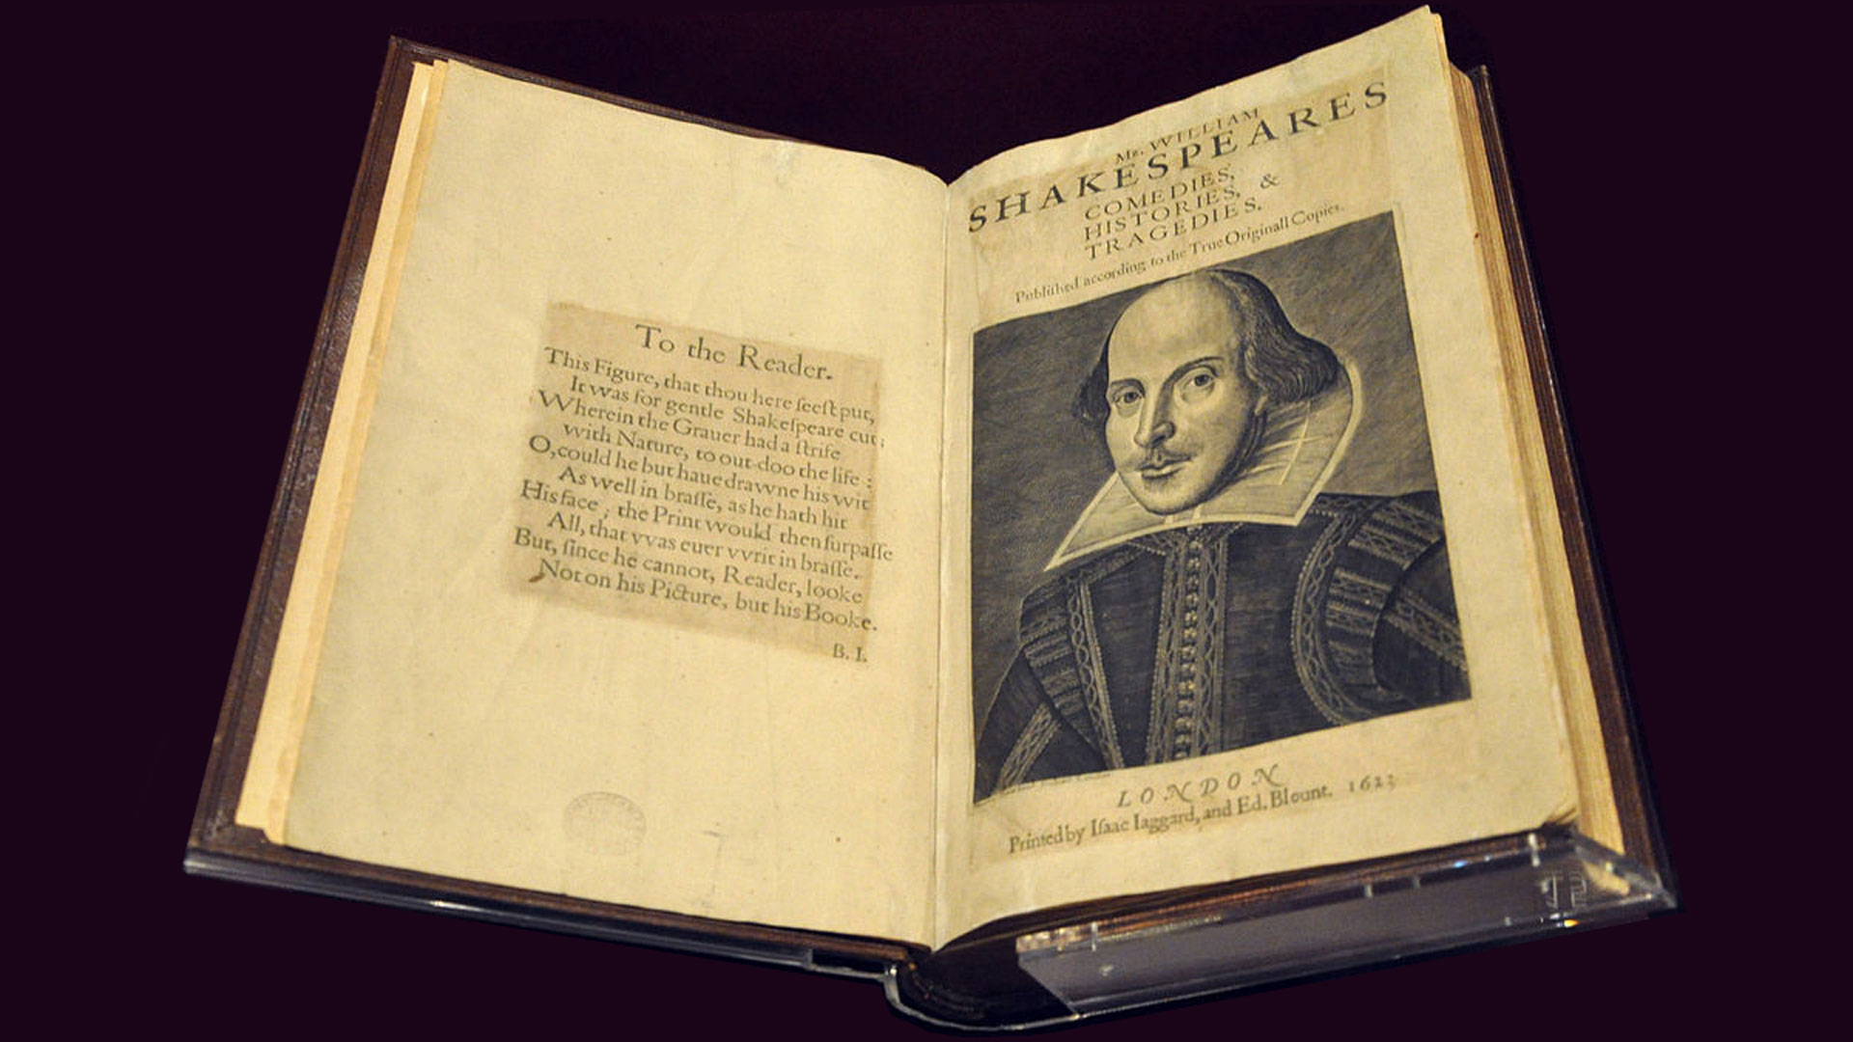
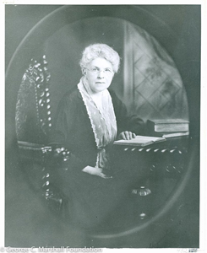
Elizabeth Wells Gallup

Slide 5
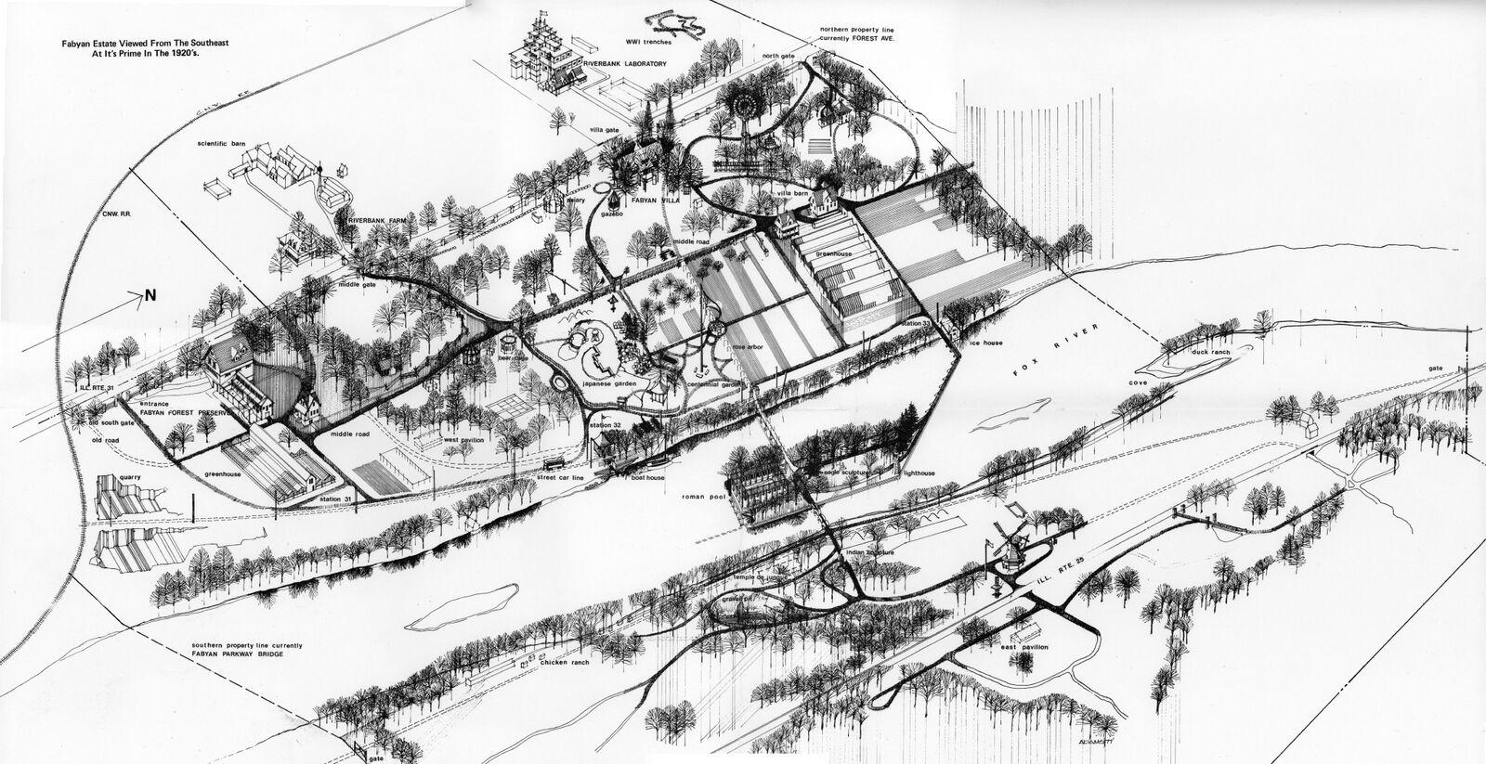
Riverbank
This 350 acre estate was bought up gradually by Colonel George Fabyan and his wife, Nelle, from 1907-1930.

Slide 6
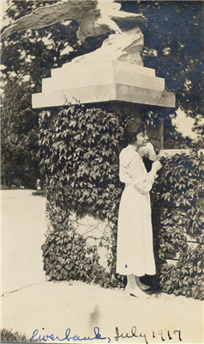
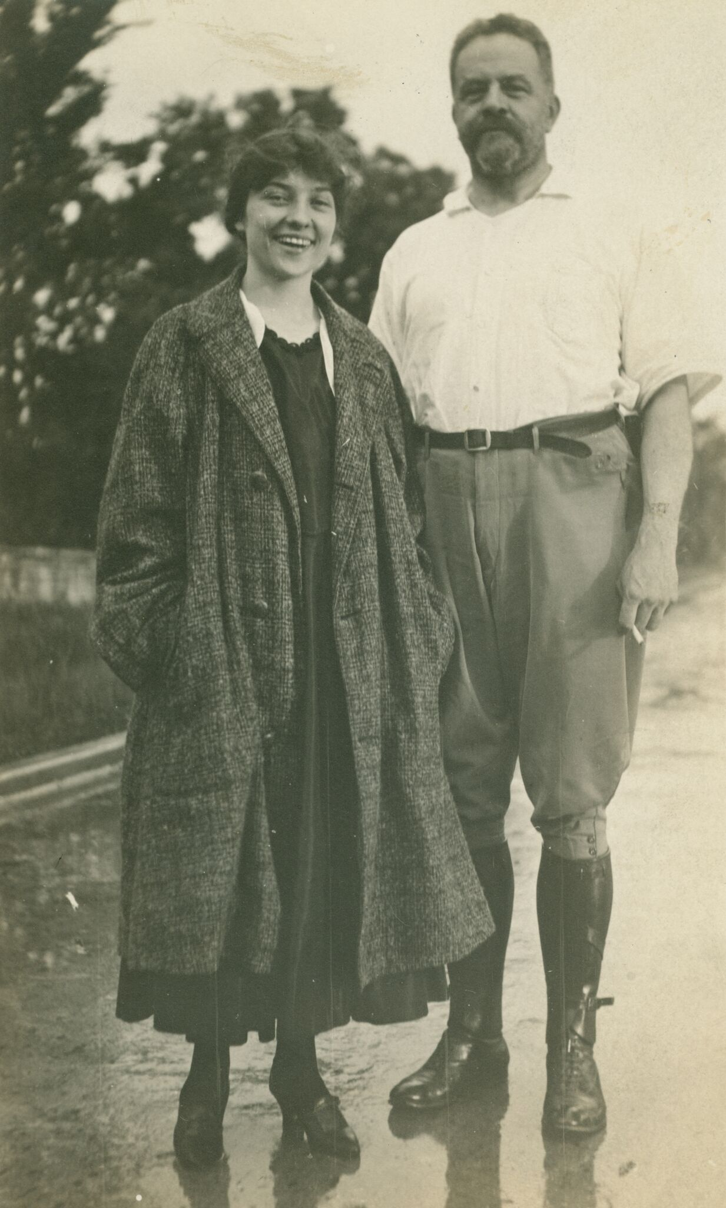

Slide 7
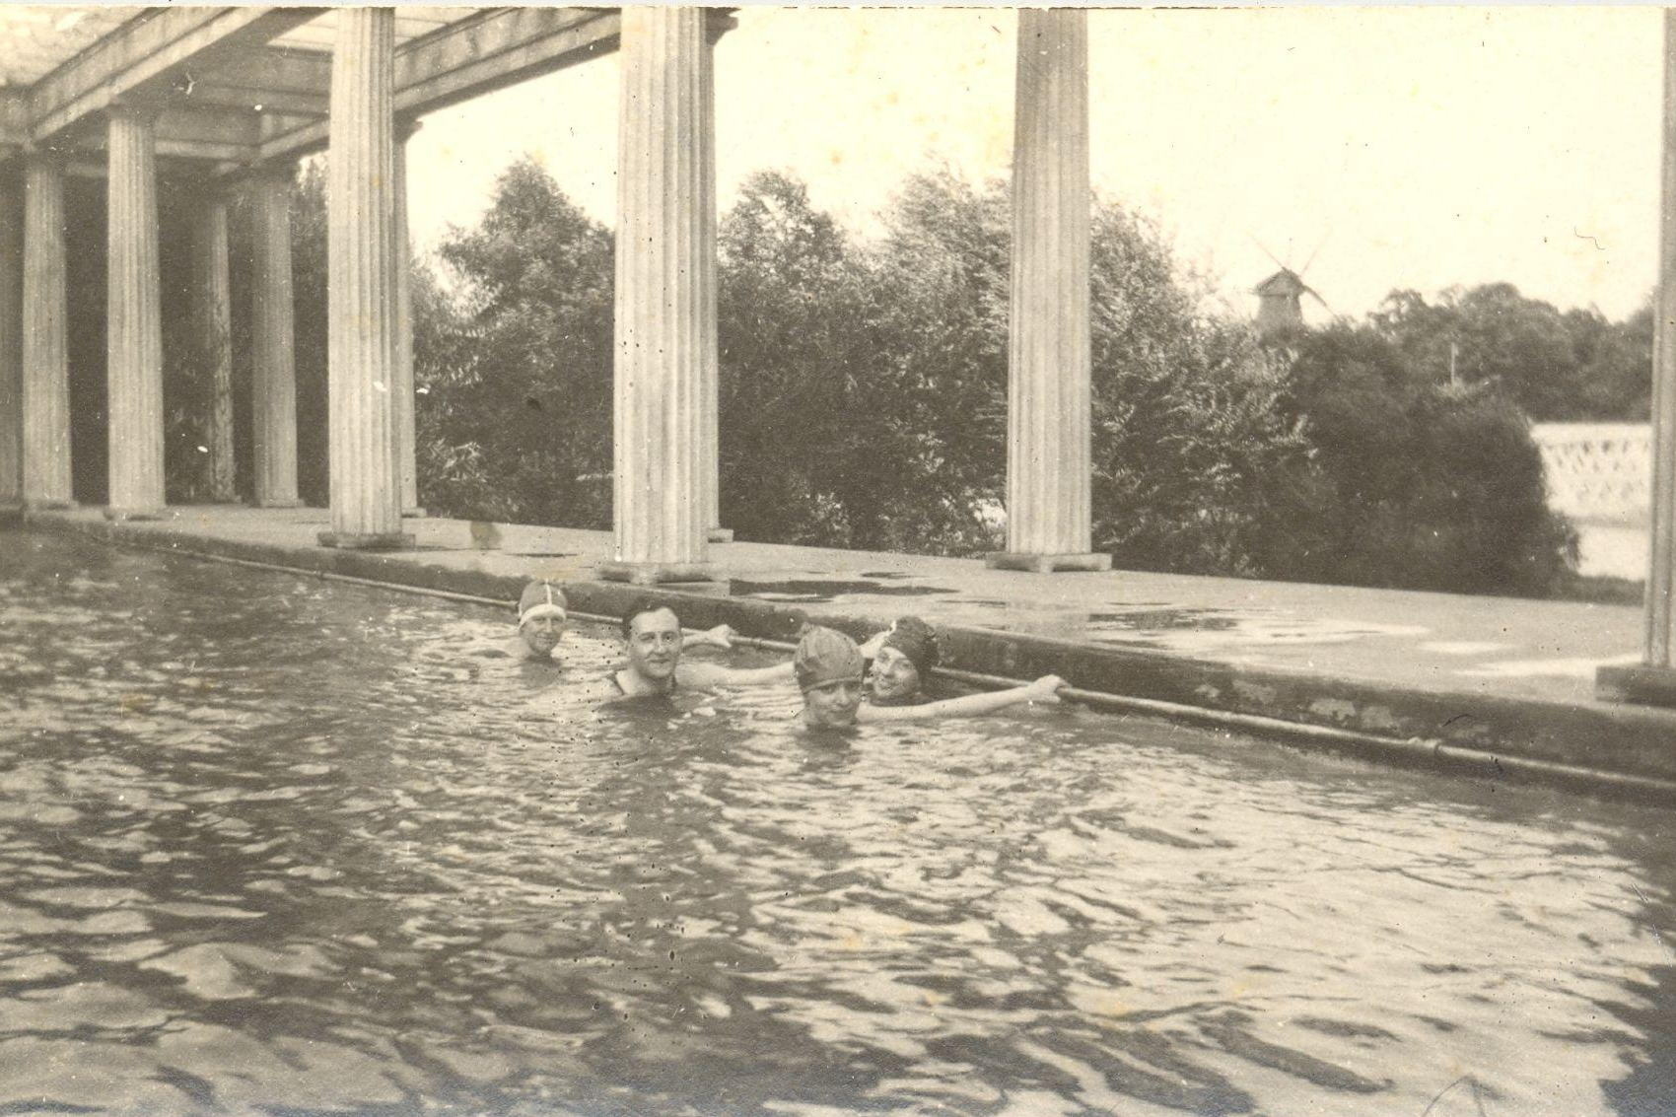

Slide 8
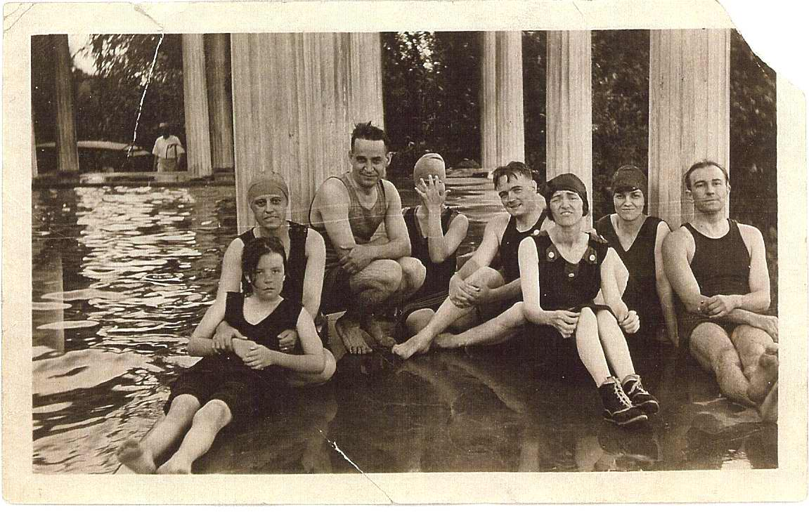

Slide 9
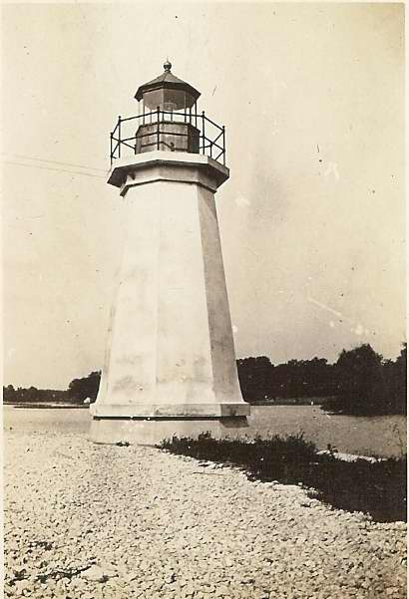
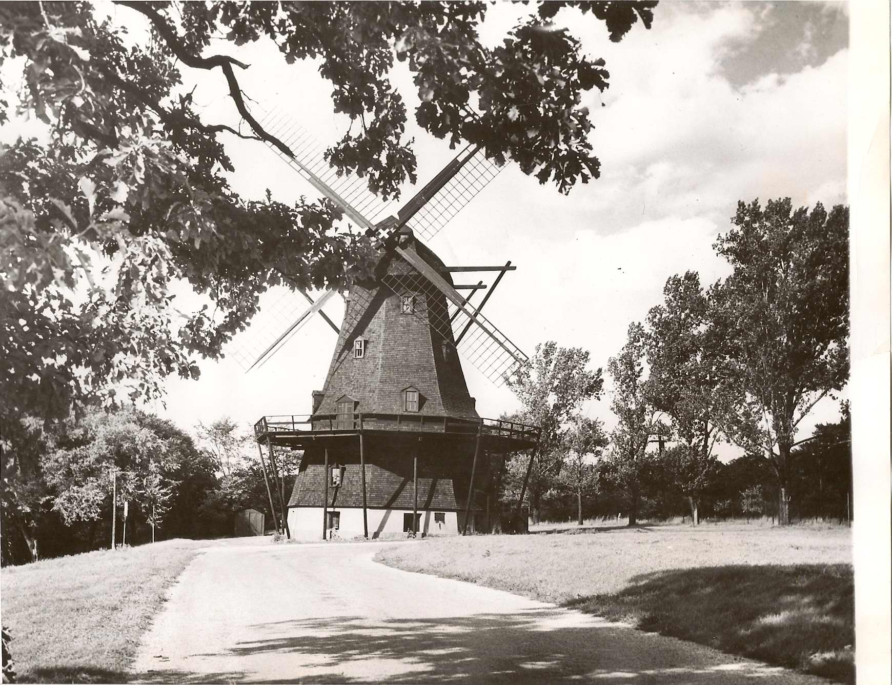

Slide 10
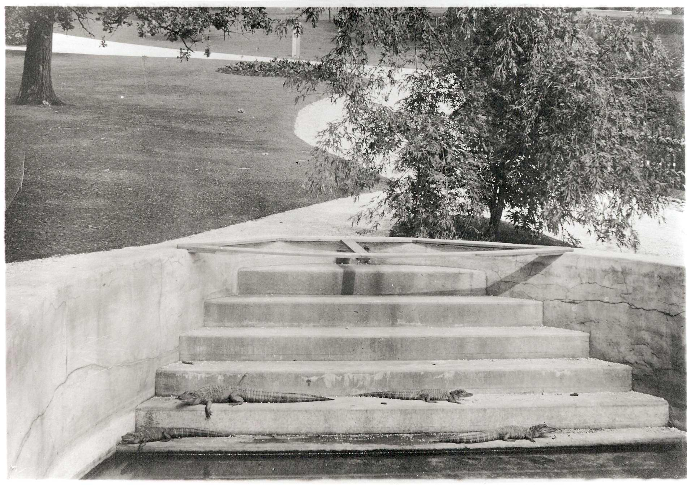
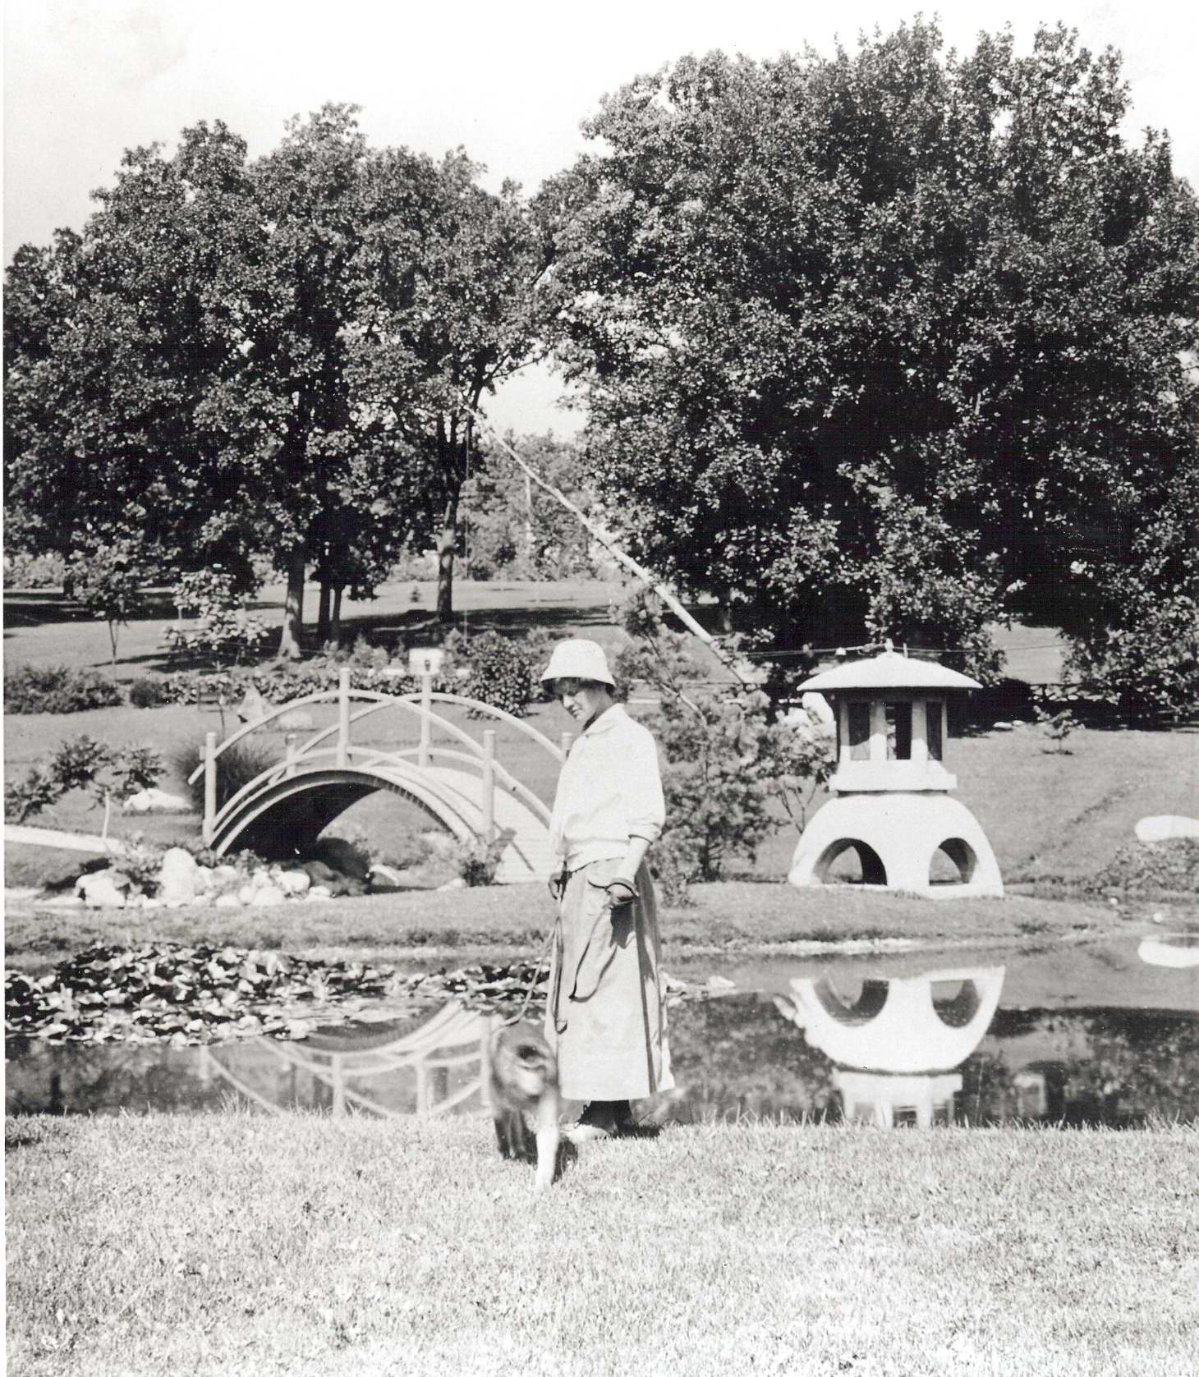
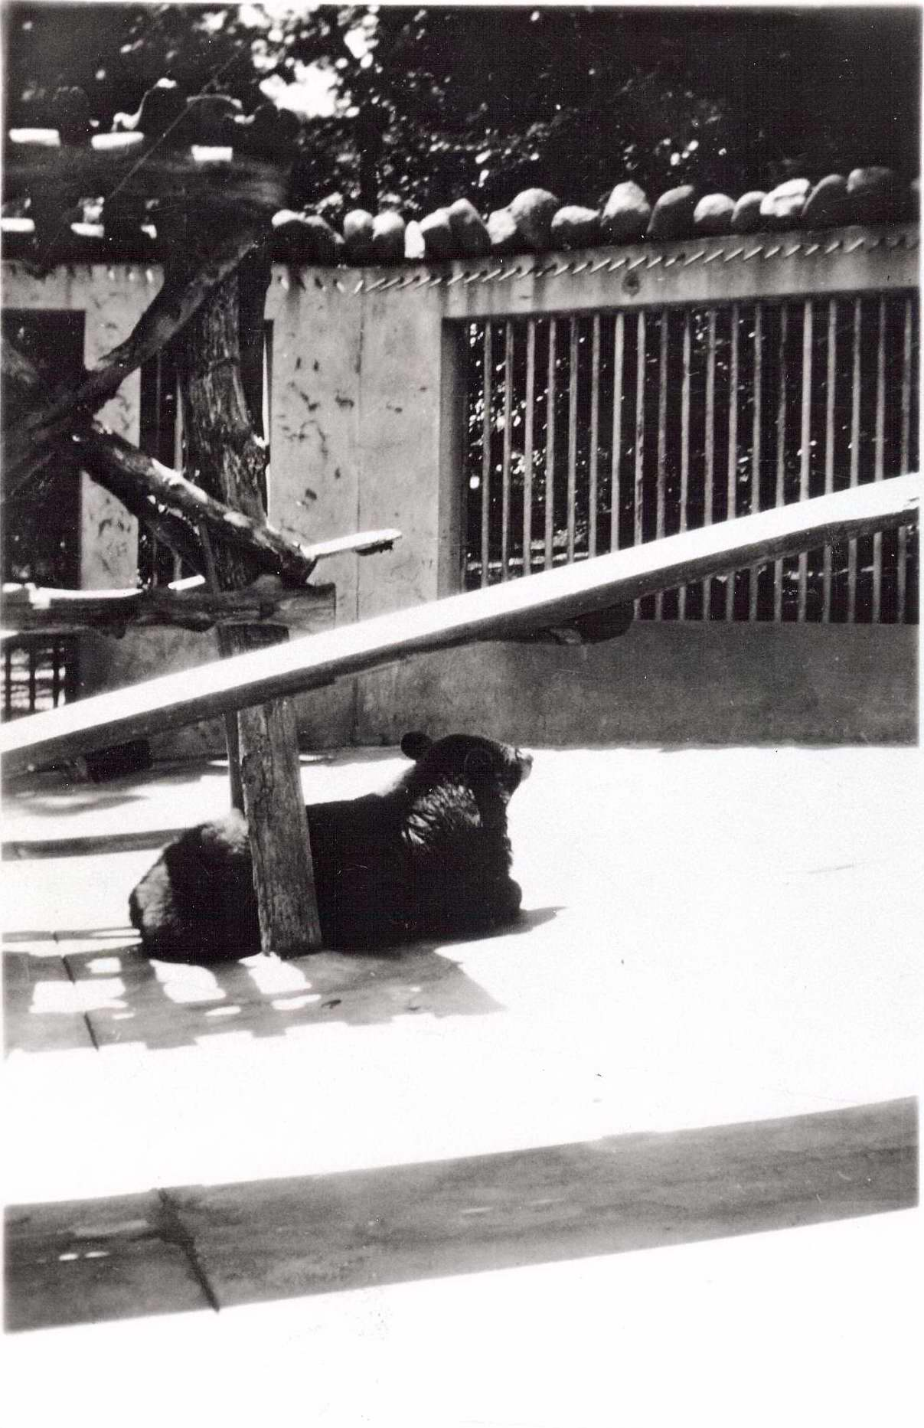

Slide 11
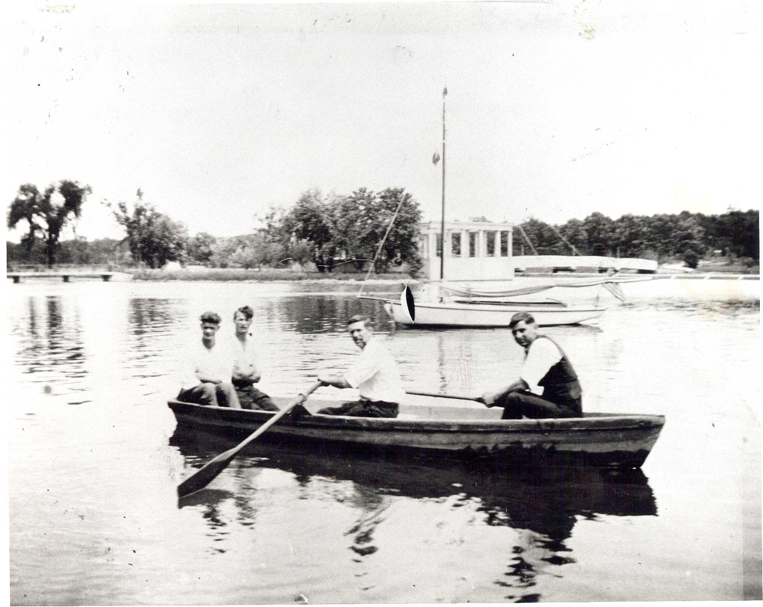
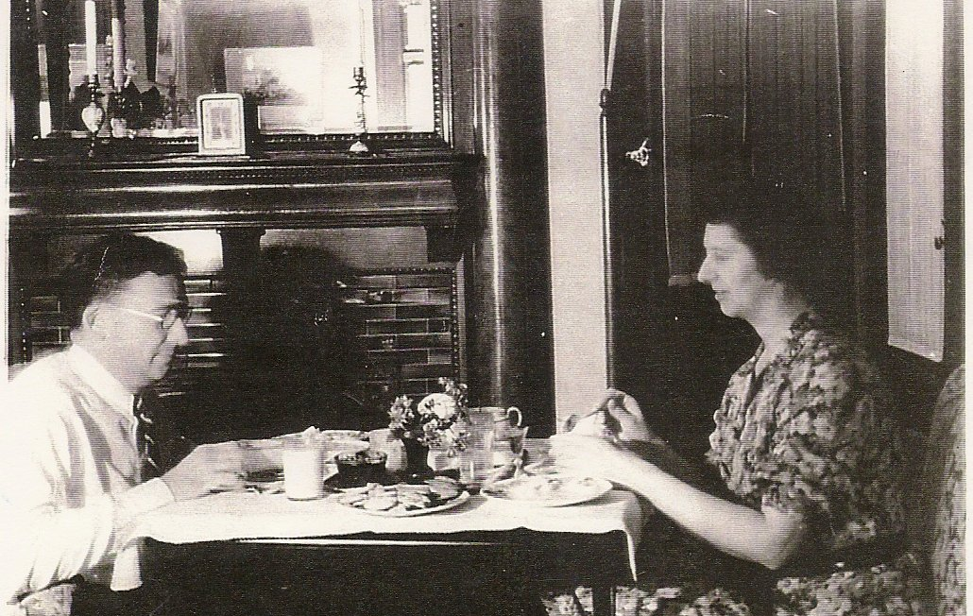
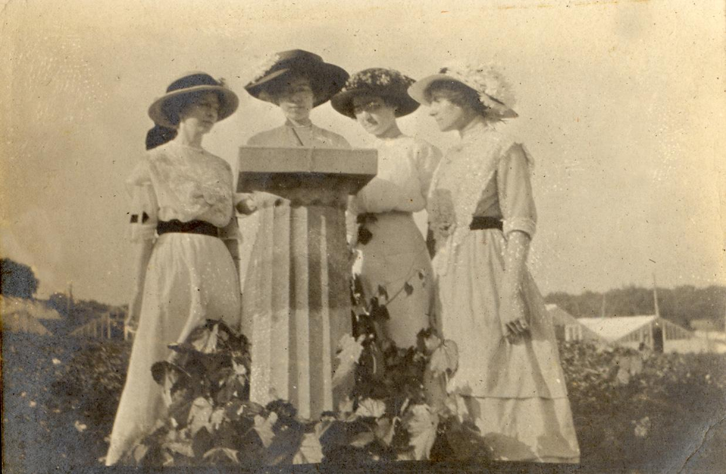
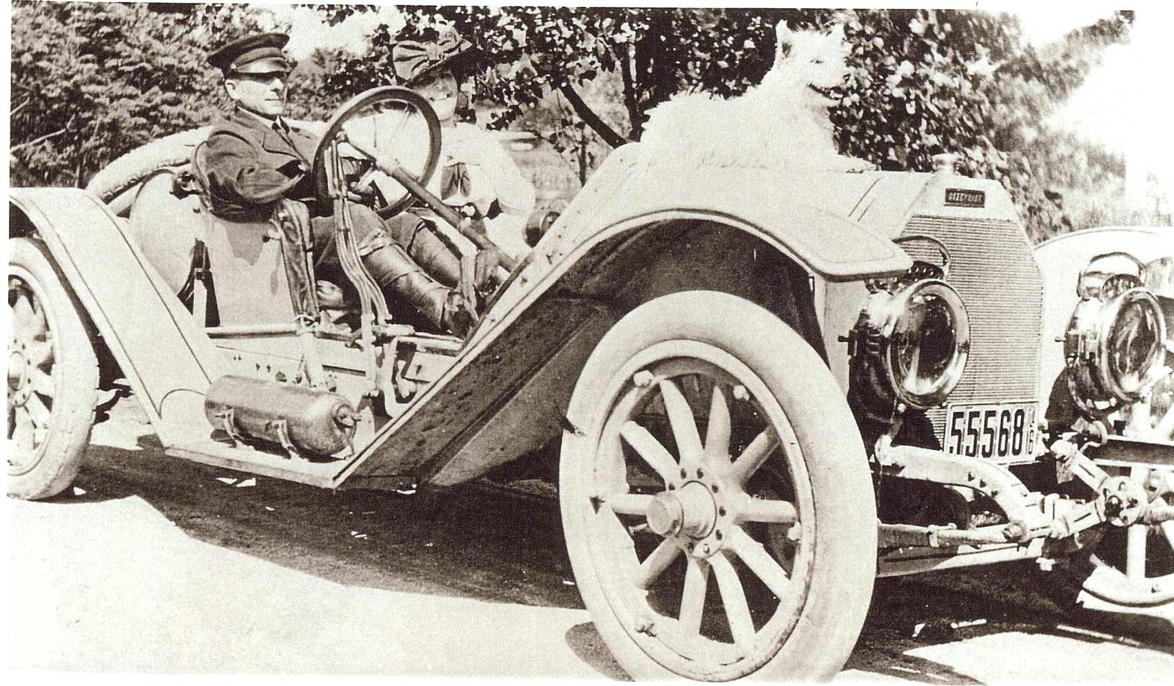
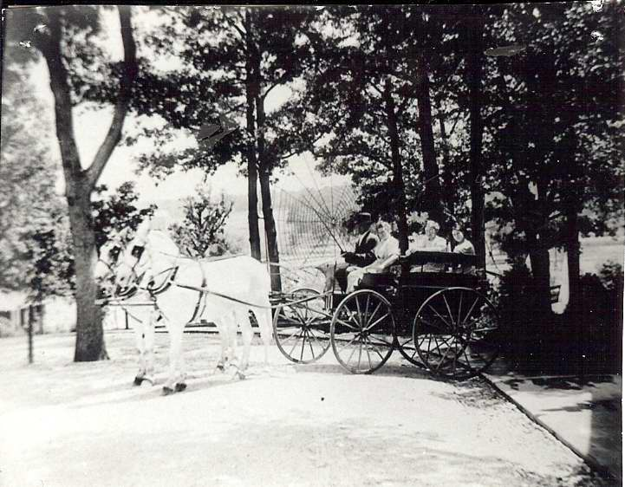

Slide 12
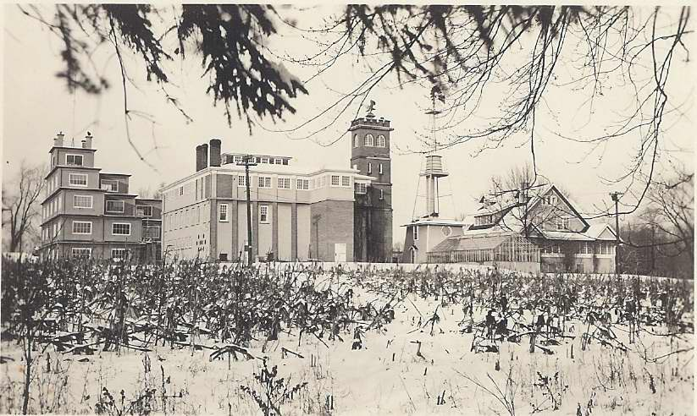

Slide 13
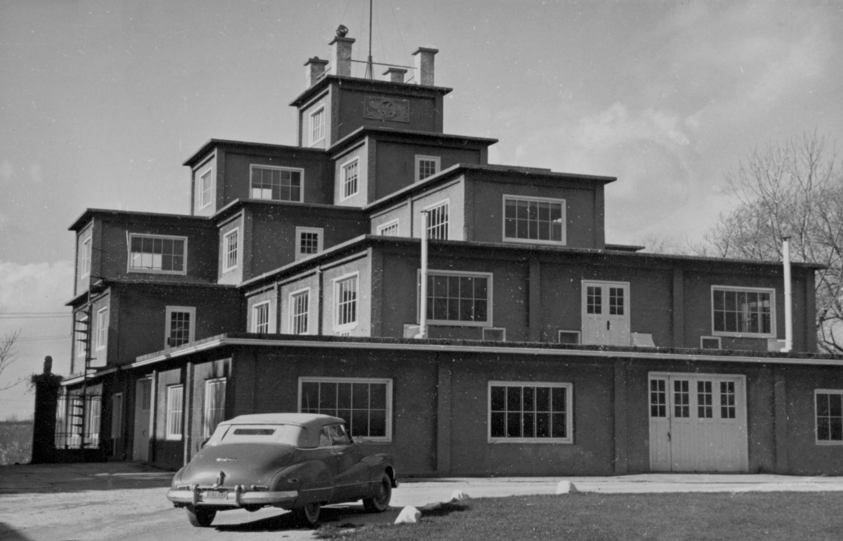

Slide 14
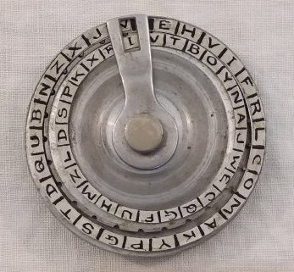
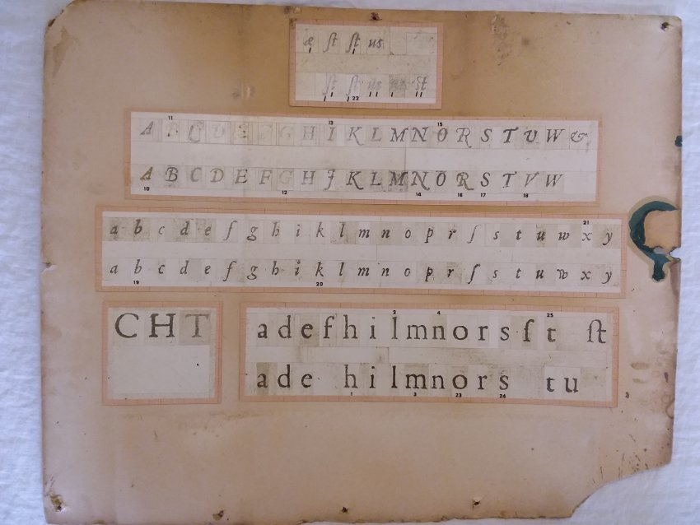
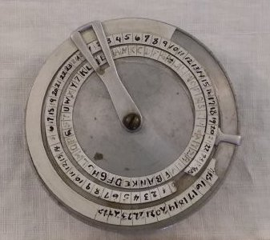

Slide 15
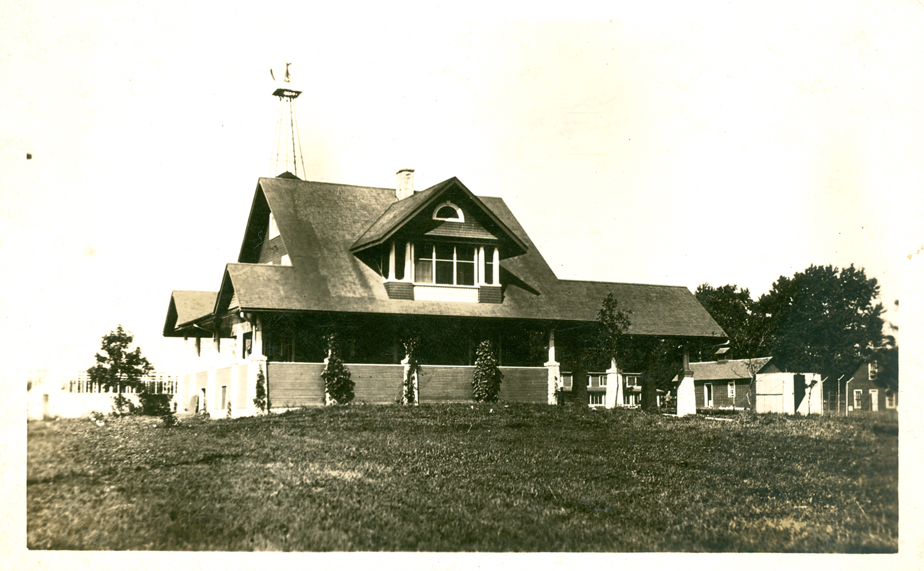
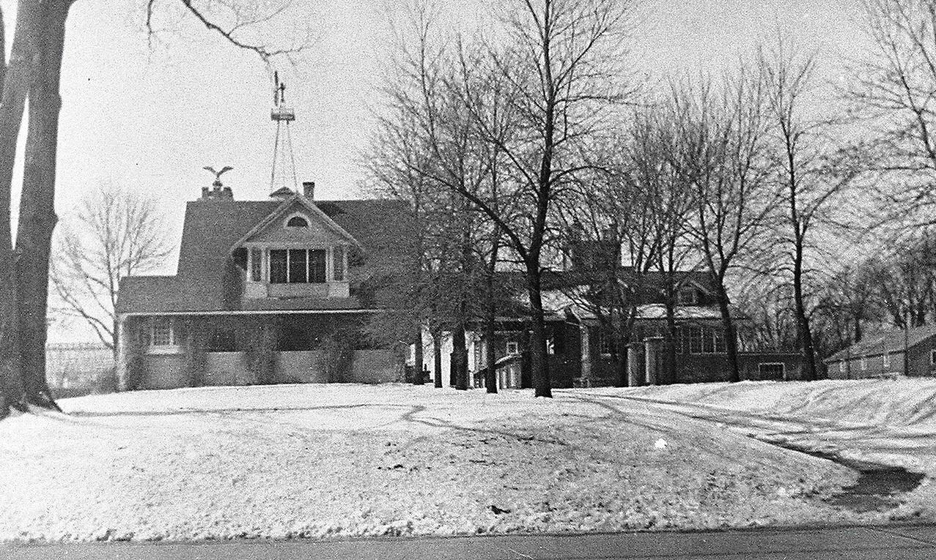
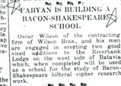

Slide 16
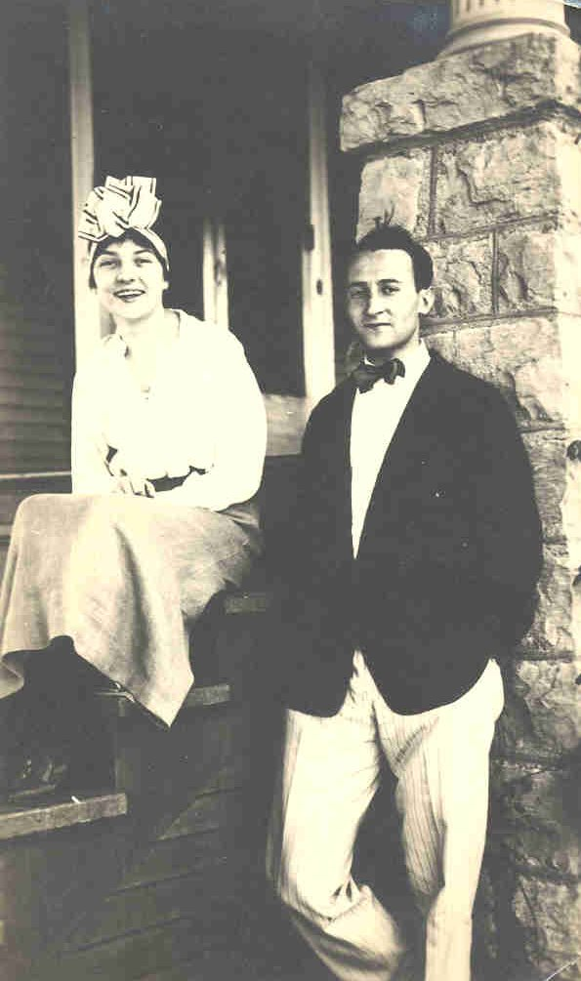
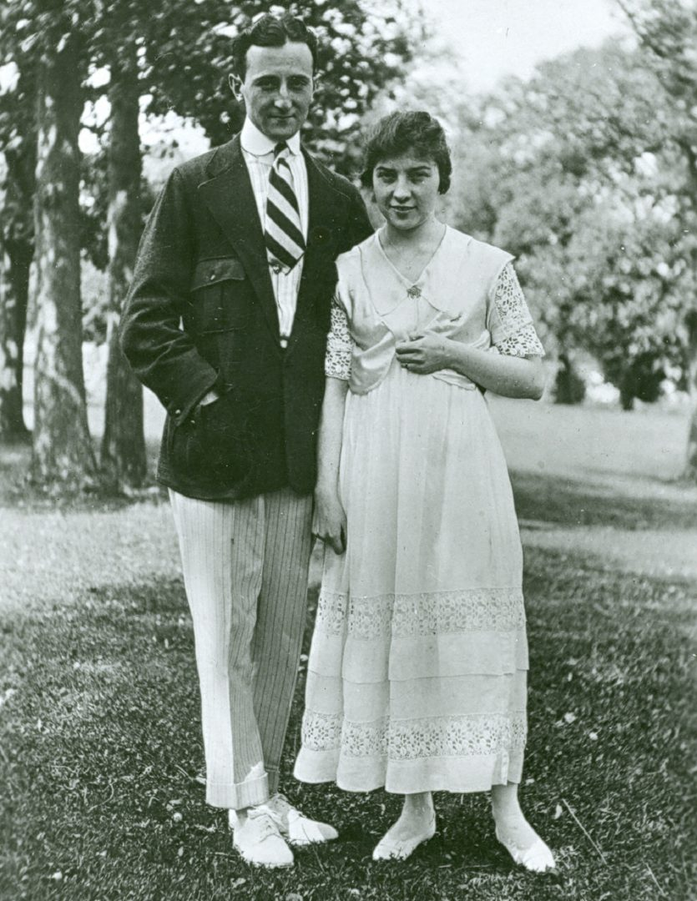
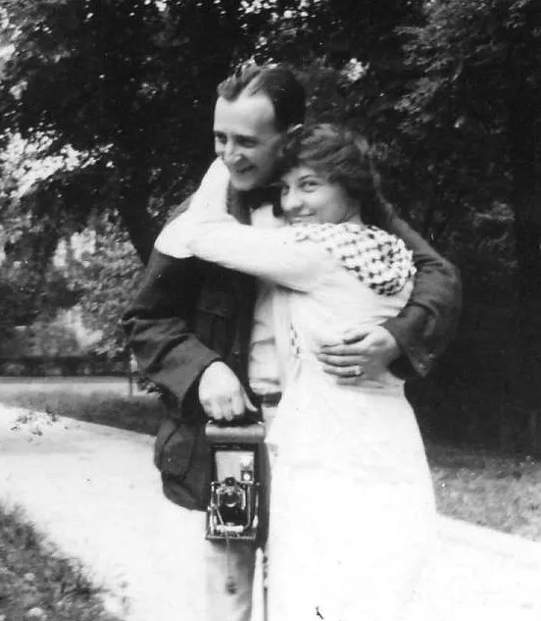
“I was seduced.”

Slide 17
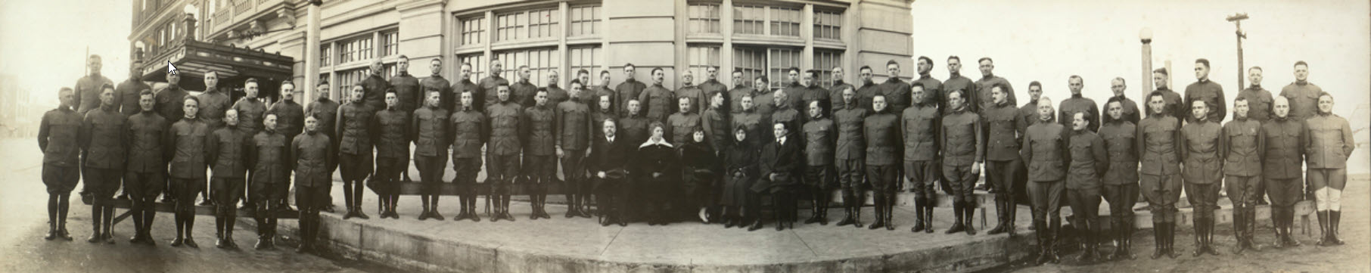

Slide 18
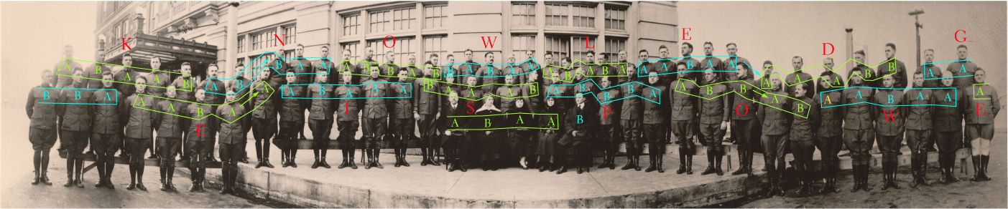

Slide 19
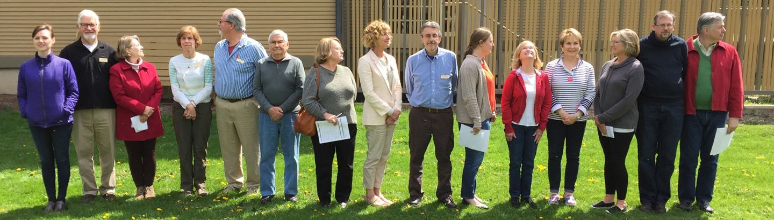
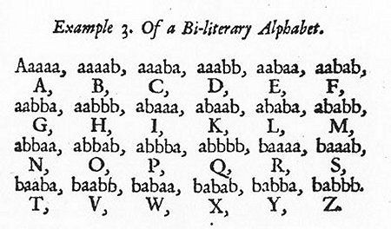

Slide 20
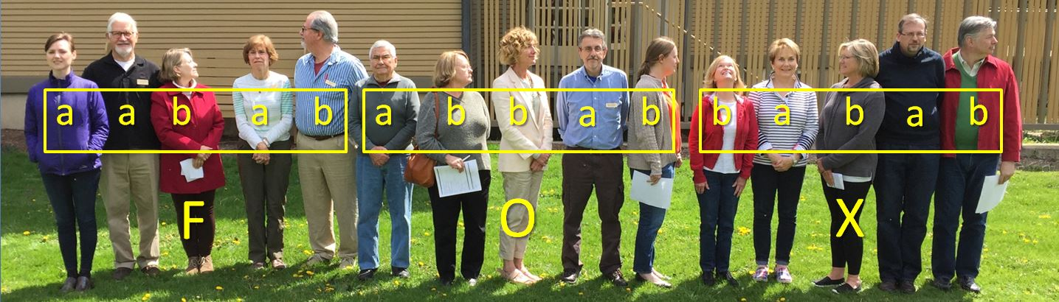

Slide 21
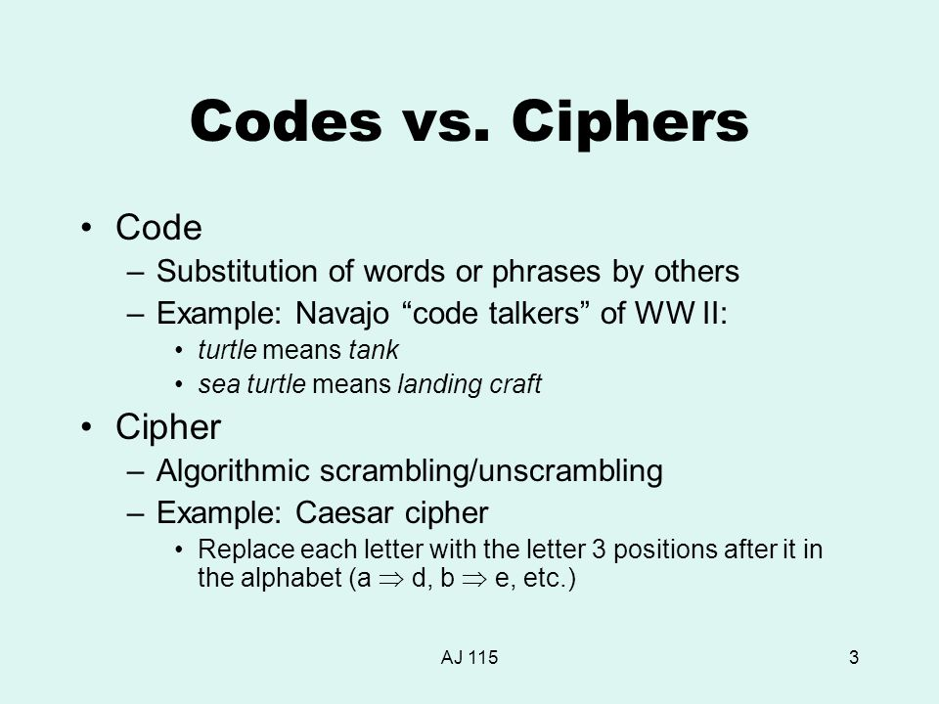
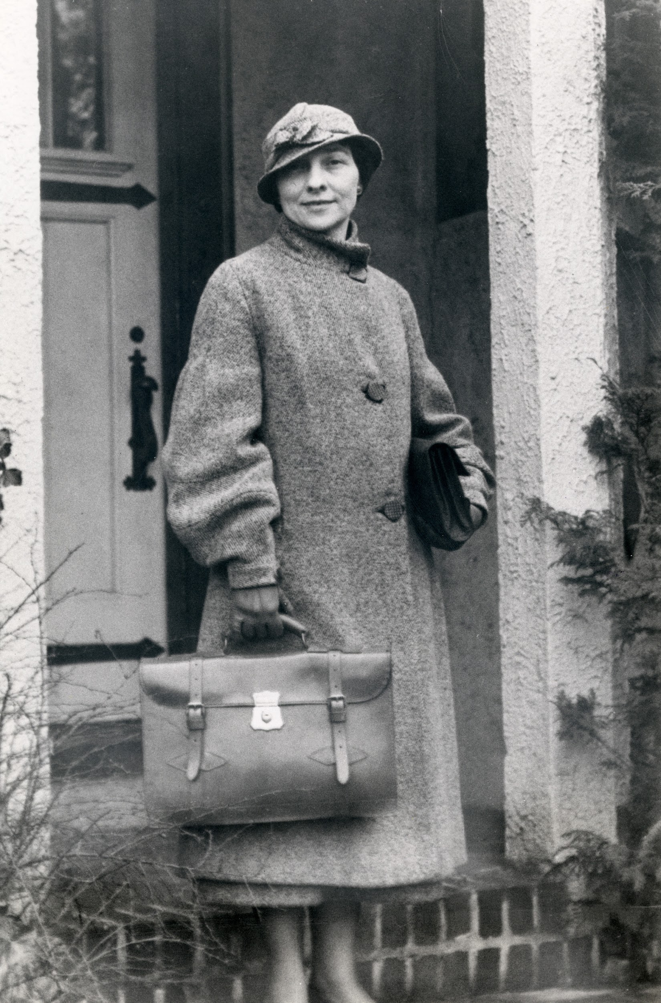
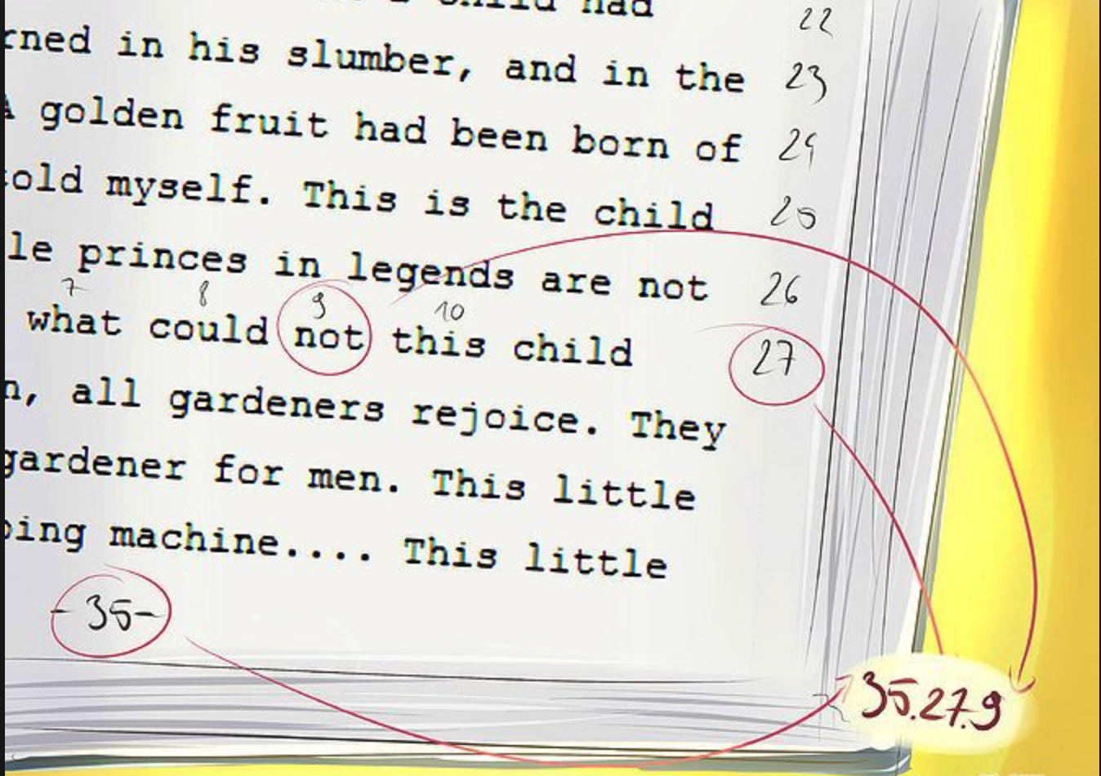
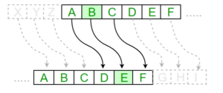
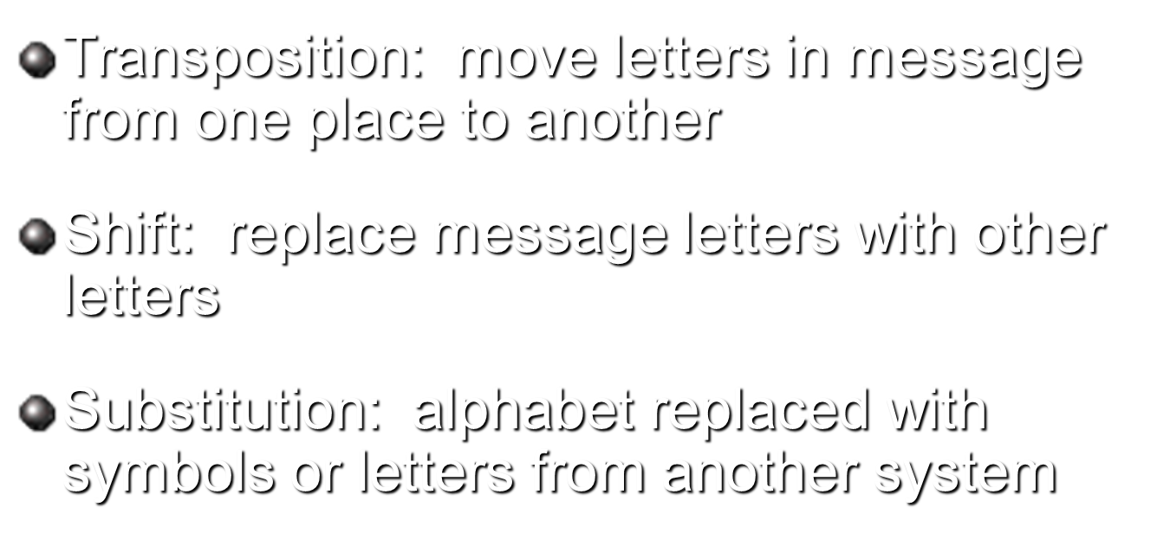

Slide 22
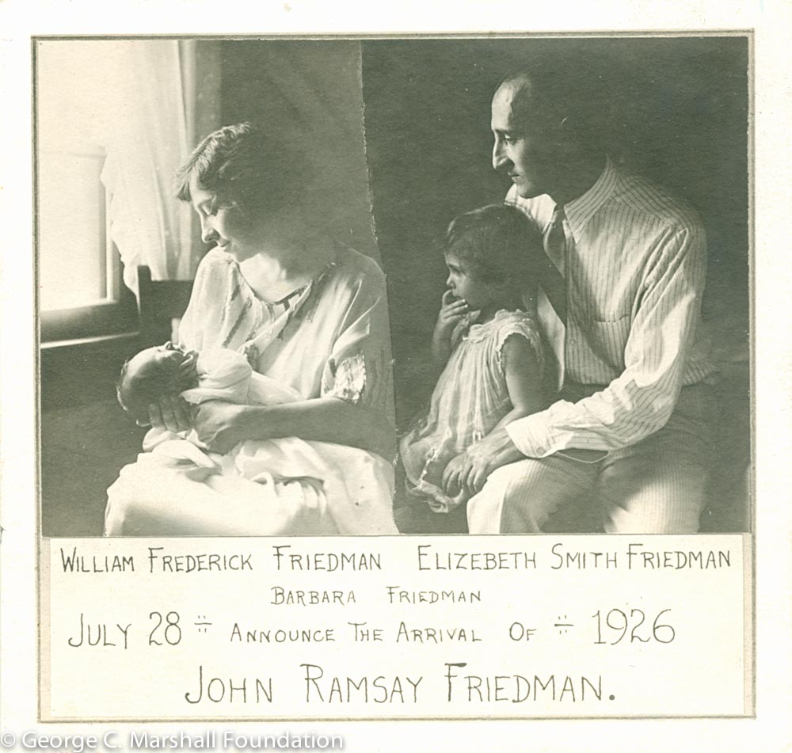
Riverbank & World War I
1892 - Elizebeth is born in Indiana
1916 - Riverbank Codebreaking Begins
1917 - Married to William Friedman, WWI begins
1918 - William went to war as a codebreaker in the field, Elizebeth leaves Riverbank
1921 - William was employed as a contract cryptologist by the War Department’s Signal Corps to solve enemy codes and ciphers.
1922 - Elizebeth worked for the U.S. Navy
1923-26 - Two children are born, Barbara & John

Slide 23
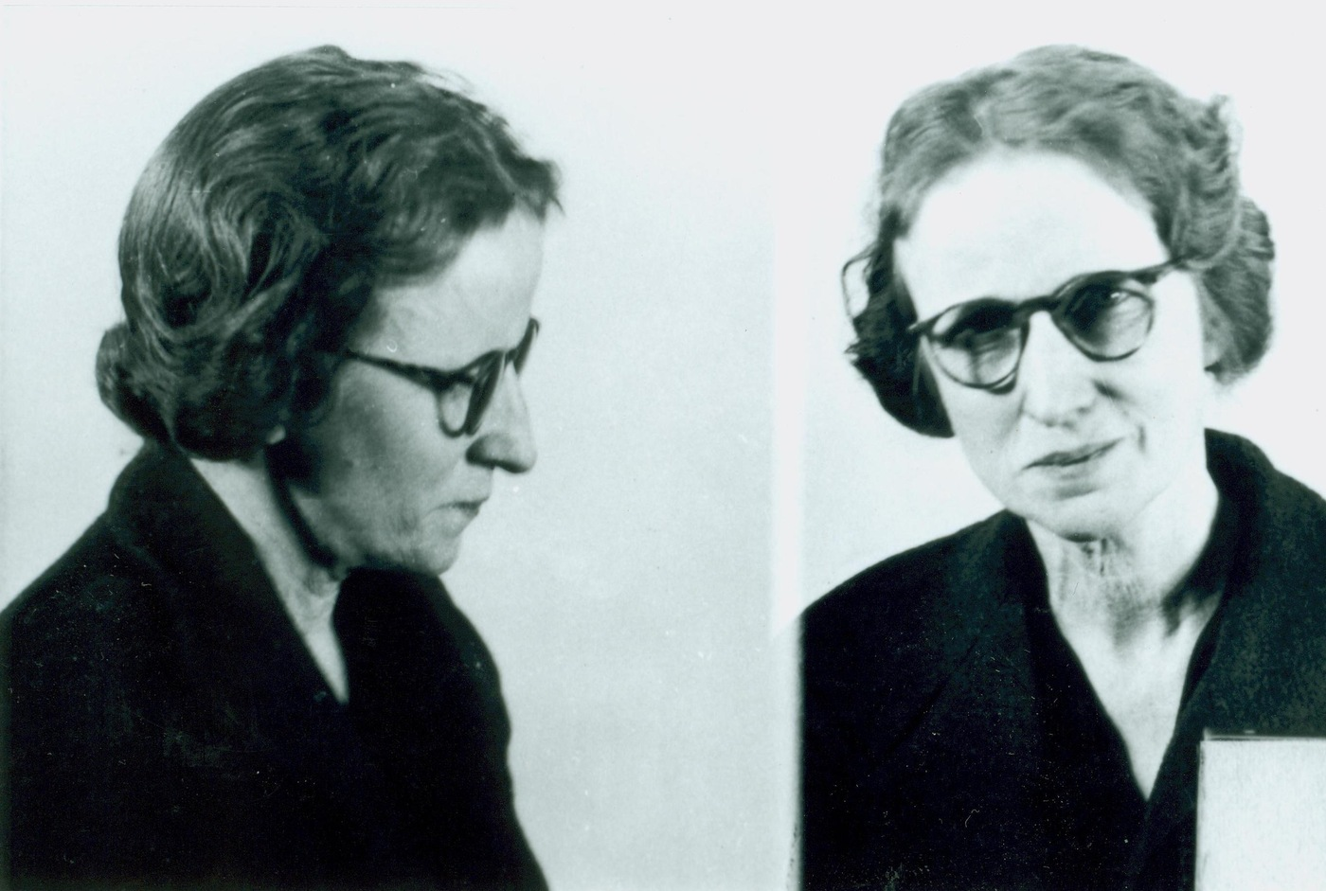
Bootleggers & the Coast Guard
1926 - Intelligence officer of the U.S. Coast Guard, called Elizebeth to work with him on developing counter-intelligence to enforce Prohibition laws against rumrunners
1933 - Trials resulted in convictions against thirty-five bootlegging ringleaders and the famous Blackboard Story
1937 - Dealt with an opium dealer problem. Her solution to a complicated unknown Chinese enciphered code, in spite of her unfamiliarity with the language, was key to the successful convictions.
“The letter, purportedly from a Portland, Oregon woman to an individual in Buenos Aires, Argentina, dealt with a “wonderful doll hospital” and observed that the writer had left her three “Old English dolls” for repairs. Also mentioned in the letter were “fish nets” and “balloons.”
FBI Laboratory cryptographers examined the letter and concluded that the “three Old English dolls” probably were three warships and the doll hospital was a shipyard where repairs were made.”
Elizebeth caught Velvavee Dickinson in 1944.
The FBI website still claims this as their success.

Slide 24
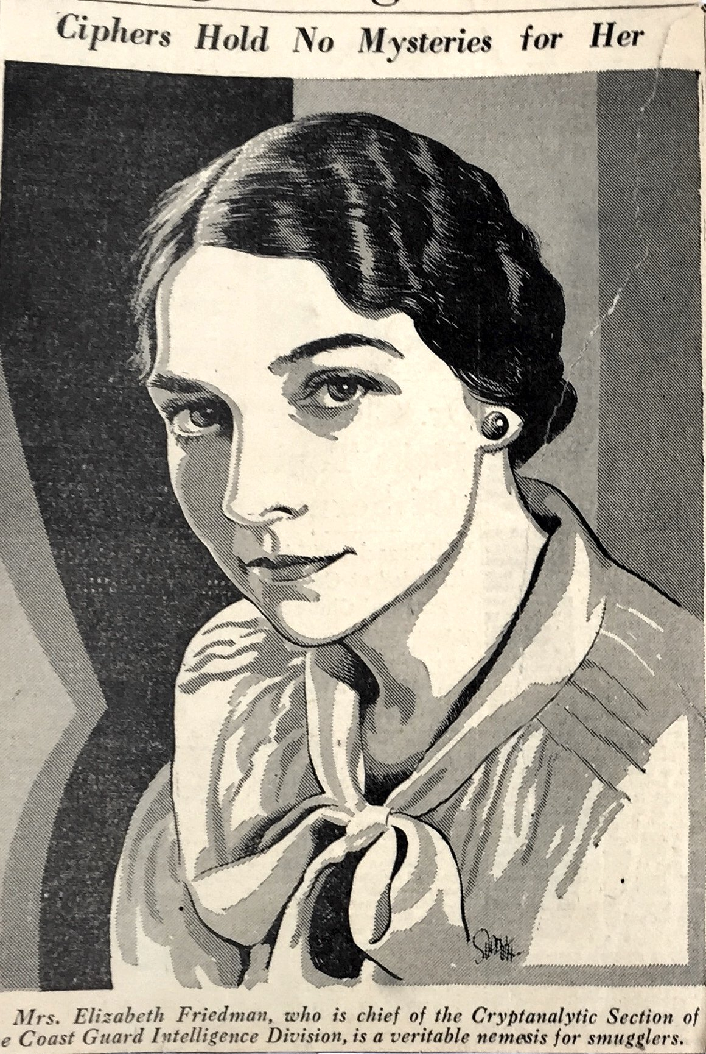
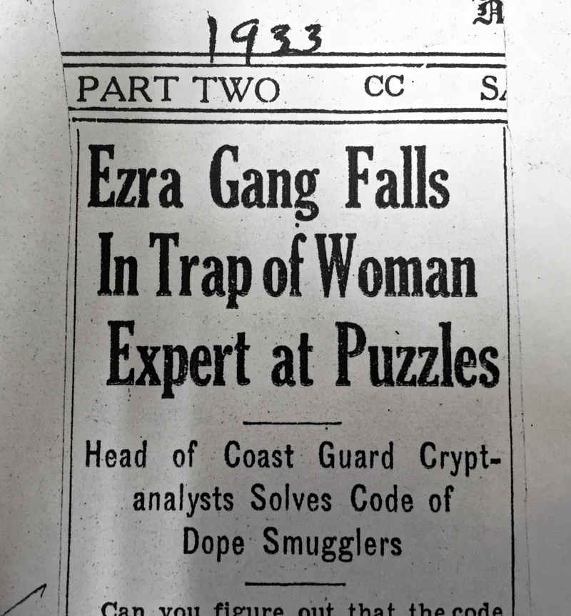
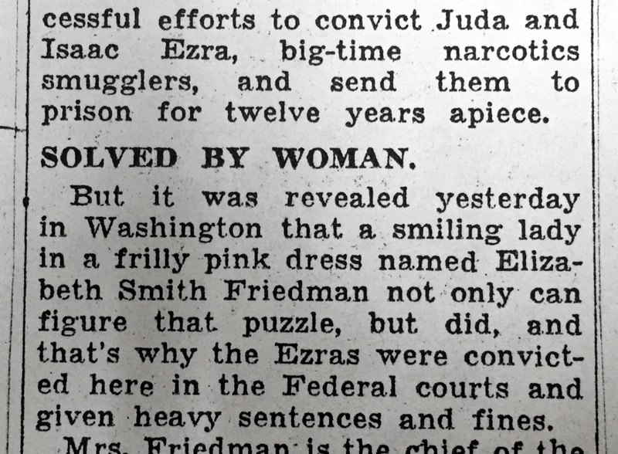
In the 1920s, Elizebeth ran a cryptanalytic unit under the U.S. Coast Guard to monitor illicit smuggling rings—the first woman to ever lead such an initiative.
She would intercept and solve the coded messages of mobsters and criminal gangs, delivering them to the Coast Guard. Elizebeth and her assistants’ work resulted in 650 criminal prosecutions, and she testified as an expert witness in 33 cases against narcotics smugglers.

Slide 25
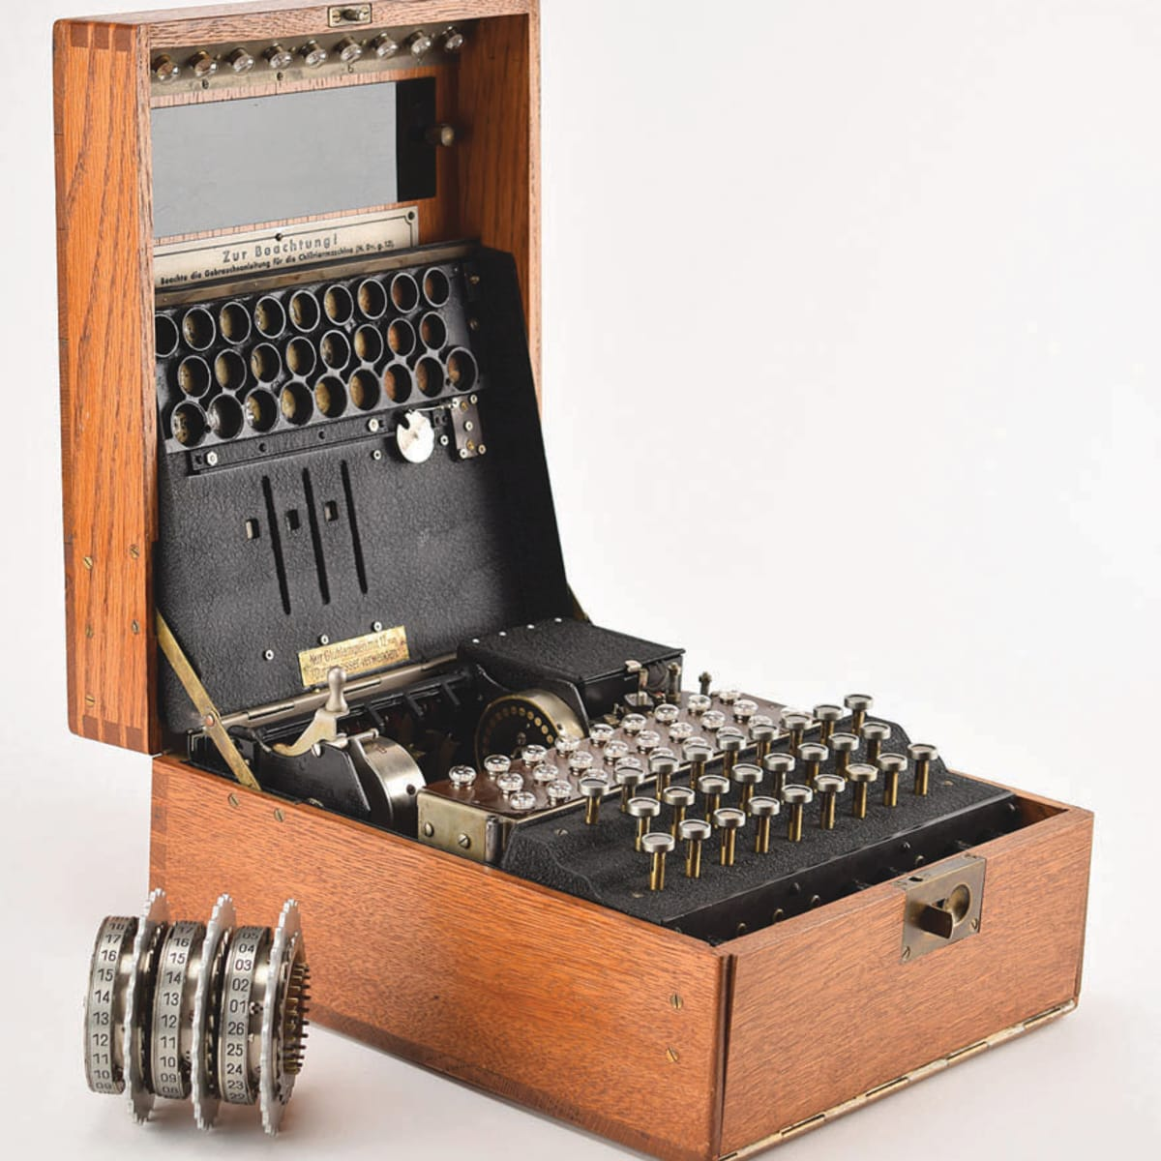

In 1942, Friedman’s worst fear materialized. Cover transmissions from the Nazis in Brazil abruptly stopped—a sign that her targets had discovered they were being spied on. As it turned out, FBI director Hoover, eager to make a career-defining move, had tipped off Nazi spies to the U.S.’ intelligence activities by hastily raiding sources in South America.
Friedman was left to deal with the aftermath, which PBS’ Butler describes as the “greatest challenge of her career.”
Adds Butler, “Even after Hoover’s gambit set her efforts back by months, Friedman’s response was what it had always been: She simply redoubled her efforts and got back to work.”
World War II
1940 - William’s team breaks the Japanese Code PURPLE
1941 - Navy took over her unit and she was demoted her because of her gender.
1942 - Elizebeth studies transmissions from Nazi Spies in South America - Codename Sargo
1943 - Her team solves 3 enigma machines in South America. The same work is being done in the UK, but British officials panicked about Elizebeth’s team, largely because of public issues with the FBI
1944 - Her boss receives 6 medals of honor, she receives none

Slide 26



1945 - Elizebeth retires
1957 - William & Elizebeth publish “The Shakespearean Ciphers Examined”
1969 - William passes away
1980 - Elizebeth passes away
2008 - ???

Slide 27


Slide 28


Slide 29

Elizabeth Smith Friedman’s work laid the foundations for the CIA, the NSA, and heavily influenced the FBI.
She pioneered the field in a time when the field did not exist.
William’s failing health and bipolar disorder did not stop them from publishing in retirement. Elizebeth was determined to set the record straight about their lives, especially William’s work.
She carefully collected all their documents. They are now held by the Marshall Foundation. The remaining government documents are in the Library of Congress.

Slide 30
At this point you might be wondering, “Why haven’t we ever heard of Elizebeth Smith Friedman?”
Following the Espionage Act, she was sworn to secrecy. She took her secrets to the grave.
Her full documents were declassified in 2008.

Slide 31




Want to learn more?

Slide 32





Thank You!
Questions? Vivien Lasken
+1 630 377 6424
fabyanvilla@ppfv.org
www.ppfv.org

